Slide 1
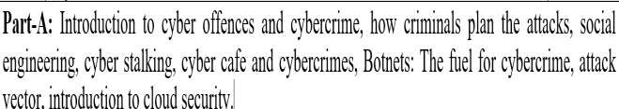
UNIT 3
Cyber Offences and Countermeasures

Slide 2
Course Outcomes (COs)
Upon completion of course the students will be able to
analyze cyber offences and implement effective countermeasures

Slide 3
Introduction
The rapid growth of computers, smartphones, and the Internet has transformed communication, business, education, and government services.
This digital transformation has also led to an increase in illegal activities conducted through cyberspace. These illegal activities are known as cyber offences and cybercrime.
They pose serious threats to individuals, organizations, and governments by compromising confidentiality, integrity, and availability of information.

Slide 4
Cybercrime
Definition:
Cybercrime is any criminal activity in which a computer, network, or
digital device is used as a tool, target, or both to commit an offence.
Examples:
Hacking into a company's database
Online banking fraud
Identity theft
Ransomware attacks
Phishing emails
Spreading computer viruses

Slide 5
Cyber Offence
A cyber offence is any act that violates cyber laws and is committed using computers, communication networks, or electronic devices. Every cyber offence is punishable under applicable cyber laws.
Examples of cyber offences:
Unauthorized access to computer systems
Data theft
Email spoofing
Cyberstalking
Website defacement
Distribution of malicious software

Slide 6
Classification of Cybercrime
Crimes Against Individuals
Crimes Against Property
Crimes Against Organizations
Crimes Against Government

Slide 7
Common Types of Cyber Offences
Cyber Offence | Description
Hacking | Gaining unauthorized access to a computer or network.
Phishing | Sending fake emails or websites to steal personal information.
Identity Theft | Misusing another person's personal information.
Malware | Creating or spreading malicious software.
Ransomware | Encrypting files and demanding payment for their release.
Cyberstalking | Repeated online harassment or intimidation.
Email Spoofing | Sending emails using a fake sender identity.
Data Theft | Stealing confidential or sensitive information.
Website Defacement | Altering the appearance or content of a website without authorization.

Slide 8
Causes of Cybercrime
Weak passwords
Lack of cybersecurity awareness
Software vulnerabilities
Poor security policies
Financial gain
Revenge or personal motives
Political or ideological reasons
Rapid growth of Internet services

Slide 9
Prevention of Cybercrime
Use strong and unique passwords.
Enable Multi-Factor Authentication (MFA).
Update operating systems and software regularly.
Install antivirus and firewall protection.
Avoid clicking suspicious emails or links.
Encrypt sensitive data.
Back up important files regularly.
Conduct cybersecurity awareness training.
Monitor systems for unusual activities.

Slide 10
How Criminals plan the attack?
Criminals use many methods and tools to identify vulnerabilities of their target.
Criminals plan attacks were categorised into
Active
Passive
Inside
Outside
Active Attacks:
Def: To alter the system
Affects: Availability, Integrity and authenticity of data.
Passive Attacks:
Def: To gain information about the target.
Affects: Confidentiality
Inside Attack :
Def: Attempted within the security perimeter of an organisation.
Affects: Access more resources than expected.
Outside attack:
Def: Attempted by a source outside the security perimeter (insider/outsider) who is
indirectly associated with the organisation.
Sources: Either from internet or a remote access connection.

Slide 11
Phases to plan cyber crime
Information gathering. (passive attack)
Reconnaissance : To gain information about an enemy .
Starts with Foot printing.
Scanning and scrutinizing the information.
For the validity of the information.
To identify the existing vulnerabilities.
Launching an attack
Gaining and maintaining the system access.

Slide 12
Passive Attack
Information gathering about a target without their knowledge.
Ex: Watching a building to identify employees entering time
It is done using internet search or googling to gain individual or company information.
Google or Yahoo search to locate information about employees.
Tools:
GOOGLE EARTH: It is a virtual map of globe and geographic information program. It maps the earth by the
superimposition of images obtained from satellite imagery and provides aerial photography of the globe Ex: (www.earth.google.com).
INTERNET ARCHIVE: The internet archive is an internet library with the purpose of offering permanent access for
researchers, historians and scholars to historical collections that exist in digital format (Ramot et al., 2003). It includes texts, Audio moving images and software as well as archived web pages in our collections.
Ex: (www.archive.org).
PEOPLE SEARCH: People search provides details about personal information, date of birth, residential address, contact number etc. Ex: (www.whitepagesinc.com).
DOMAIN NAME CONFIRMATION: To perform searches for domain names using multiple keywords, this helps to
find every registered domain name in “com”, “net”, “org”, “edu” (www.namedroppers.com).
WHOIS: This is a domain registration lookup tool. This utility is used for communicating with WHOIS servers located around the world to obtain domain registration information. WHOIS supports IP address queries and automatically selects the appropriate server for IP address. This tool will lookup information on a domain IP address or a domain registration server or you can use the default option which will select a server for you (www.whois.net).
NSLOOKUP: The name nslookup means “name server lookup”, the tool is used on windows and Unix to query details,
including ip addresses of a particular computer and other technical details such as mail exchanger records for a domain
and name severs of a domain (www.nslookup.downloadsoftware4free.com).
eMailTrackerPro: eMailTrackerPro analyzes the E-mail header and provides the IP address of the system that send the mail (www.emailtrackerpro.com).
HTTrack: This tool acts like an offline browser. It can mirror the entire website to a desktop. One can analyze the entire
websites by being offline (www.httrack.com).

Slide 13
Active Attacks
ARPING: This is a network tool that
Broadcasts arp packets and receive replies similar to “ping”.
It is good for mapping a local network and finding used IP space
It broadcasts, who has an arp packet on the network and prints answers.
It is very useful when trying to pick an unused IP for a net to which routing does not exist as yet
Bing: This tool is used
for pinging the bandwidth.
It is one of the point-to-point bandwidth measurement tool
It can calculate the blank throughput between any couple of networks. (htttp:ai3.asti.dost.gov.ph/sat/bing.html).
It is also called “Rattling the doorknobs” or “Active reconnaissance”
It can provide confirmation to an attacker about security measures in place .
Tools:
Dsniff : This is network auditing tool to capture username, password and authentication information on a local subnet.
DNStracer: This tool is used
for determining the data source of a DNS server
Notifies the continuous process of DNS server
Hmap: This tool is used
To get the fingerprinting of web servers
to identify the version of server, vender of the server, model of the server and more
Nmap: This tool is used
to scan the port address of the network,
It takes the fingerprint of operating system version, service and it can scan the network rapidly
(http://insecure.org/nmap).

Slide 14
Scanning and scrutinizing gathered Information
Objectives of scanning:
Port Scanning : Where information goes in and out of a computer
Identify open/close ports and services
Network Scanning: Understand IP addresses and computer network systems information.
Vulnerability Scanning: Understand the existing weaknesses in the system.
Scrutinizing : “Enumeration”
Objectives:
Valid user or group
Network resources and /or shared resources
OS and different applications that are running on the OS
S.No | Port Number | Port Description
1 | 1 | TCP Port service Multiplexer
2 | 18 | Message send protocol
3 | 20 | FTP data
4 | 25 | SMTP
5 | 43 | WHOIS

Slide 15
Launch the Attack
After scan and enumeration, the attack is launched using the following steps:
Crack the password
Exploit the privileges
Execute the malicious commands/applications
Hide the files
Cover the tracks like delete the access logs.
Note:
The attackers spend 90% of the time in Reconnaissance, Scanning and scrutinizing on a target.
Only 10% of the time in launching the attack.

Slide 16
Social Engineering
It is a way for criminals to gain access to information systems.
The purpose of social engineering is usually to secretly install spyware, other malicious software or to trick persons into handing over passwords and/or other sensitive financial or personal information
What are they looking for
Obtaining simple information such as your pet's name, where you're from, the places you've
visited; information that you'd give out freely to your friends.
Take a close look at some of the 'secure' sites you log into. Some have a 'secret question' you have to answer, if you cannot remember your username or password. The questions seem pretty tough for an outsider looking into trying to hack into your account.
What's the name of your first pet?
What is your maiden name?
When was your mother/father born?
Where were you born?
Do these sound familiar?

Slide 17
Social Engineering
It is the “technique to influence” and “persuasion to deceive” people to obtain the information or perform some action.
Social engineers exploit the natural tendency of a person to trust social engineers’ word, rather
than exploiting computer security holes.
Social engineering involves gaining sensitive information or unauthorized access privileges by
building inappropriate trust relationships with insiders.
The sign of truly successful social engineers is that they receive information without any
suspicion.
Classification of Social Engineering
Human-Based Social Engineering
Human-based social engineering refers to person-to-person interaction to get the required/desired
information.
Computer-Based Social Engineering
Computer-based social engineering refers to an attempt made to get the required/desired information by using computer software/Internet.

Slide 18
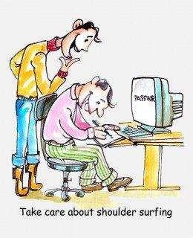
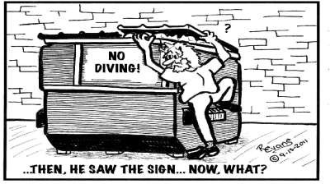
Human Based (Non Technical)
Impersonating an employee or valid user : Posing employee of same organisation.
Posing as an important user : Pretend to be an important user
Using a third person : By authorised source to use system
Calling technical support : By using Help desk
Shoulder surfing : By watching over a person shoulder
Dumpster diving : Looking in trash for information

Slide 19
Computer Based Social Engineering
Fake EMails
Email Attachments
Pop-up Windows
Protecting Yourself from Social Engineering Attack
Network defenses to repel virus
Virus protection (McAfee, Norton, Symantec, etc…)
Email attachment scanning
Firewalls, etc…
Organizations must decide what information is sensitive
Security must be periodically tested
Contact your security office immediately if you have any concerns at work

Slide 20
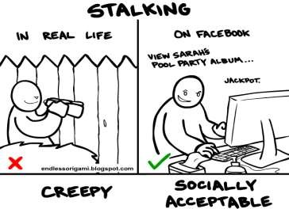
Cyber Stalking
Definition::
It is a crime in which the attacker harasses a victim using electronic communication, such as e-mail or instant messaging (IM), or messages posted to a Web site or a discussion group.
Cyberstalking messages differ
Stalking :
from ordinary spam.
Cyberstalker targets a specific
A cyberstalker relies upon the anonymity afforded by the Internet to allow them
victim with often
messages, while the
threatening
spammer
to stalk their victim without being
detected.
targets a multitude of recipients
with simply annoying messages.

Slide 21
Types of Stalkers
Mainly 2 types :
Online Stalkers :
Def: Interaction with the victim using Internet.
Ex: Email, Chat
Offline Stalkers:
Def: Begin the attack using traditional methods.
Ex: Watching daily, Personal websites.
Other types :
The four most important types are:
Rejected Stalker
Resentful Stalker
Predatory Stalker
Intimacy Stalker

Slide 22
Rejected Stalker
Most common, persistent, and intrusive
Obsessed with someone who is a former romantic partner or friend, and who has ended their
relationship, or indicates that he or she intends to end the relationship.
Resentful Stalker
Looking for revenge against someone who has upset them--it could be someone known to the
stalker or a complete stranger.
– Their behaviors are meant to frighten and distress the victim
Predatory Stalker
Least common
Are a classic sexual predator whose plan is to physically or sexually attack the victim.
Their motivated purely by the desire for sexual gratification and power over their victim
Intimacy Stalker
They seeks to establish an intimate, loving relationship with their victim.
⦁ The victim and himself were “meant to be together.”
These types of people think that the victim owes them love and affection because of all the time and effort it took for the stalker to stalk them.

Slide 23
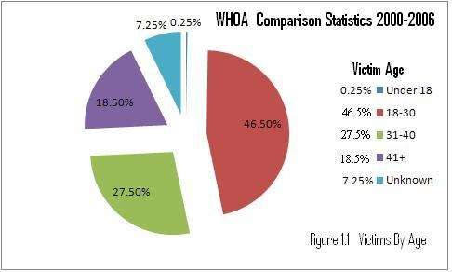
Analysis…
The majority of cyberstalkers are men and the majority of their victims are women but…..
Jane A. Hitchcock, president of WHOA says, “The most surprising thing we've seen is the rise in female cyberstalkers - this increased from 27% in 2000 to 35% in 2002 to 38% in 2003.”
According to the Working to Halt Online Abuse (WHOA) from 2000 to 2006, out of the total
cases, 2036, of cyberstalking….

Slide 24
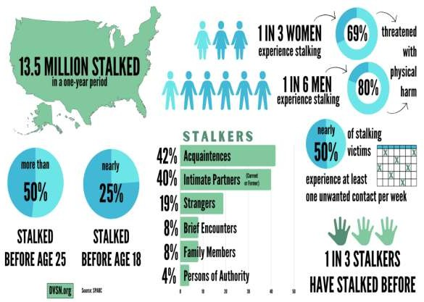

Slide 25
How stalking works?
In the following way
Personal information gathering about the victim.
Ex: Name, background, contact number, etc.
Establish a contact with victim through phone.
Stalkers will almost always establish a contact with the victims through EMail.
Some stalkers keep on sending repeated E-mail.
Post victims personal information on any illicit services website
Who were received information , start calling the victims on the given contact details.
Stalkers subscribe/register the E-mail account of the victim to
pornographic websites.
1. Real Life Incident:
– Case study: In Delhi, 40 calls in 3 days.

Slide 26
Cybercafe and Cybercrimes
Cybercrimes such as stealing of bank passwords and subsequent fraudulent withdrawal of money have also happened through cybercafes.
Cybercafes have also been used regularly for sending obscene mails to harass people.
Indian Information Technology Act (ITA) 2000 interprets cybercafes as “network service providers” referred to under the erstwhile Section 79, which imposed on them a responsibility for “due diligence” failing which they would be liable for the offenses committed in their network.

Slide 27
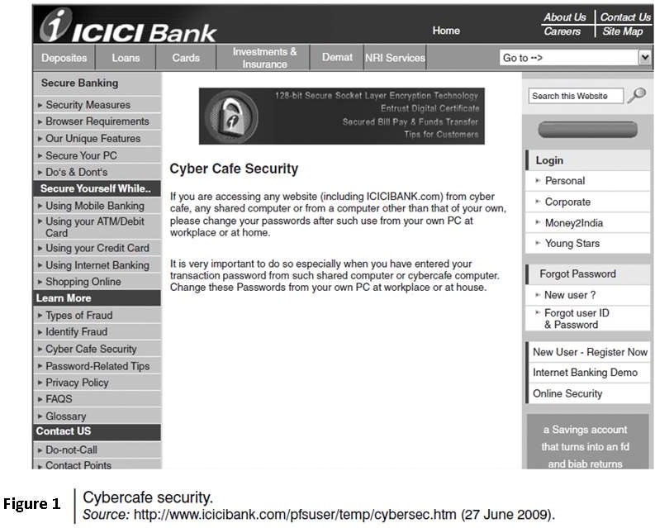

Slide 28
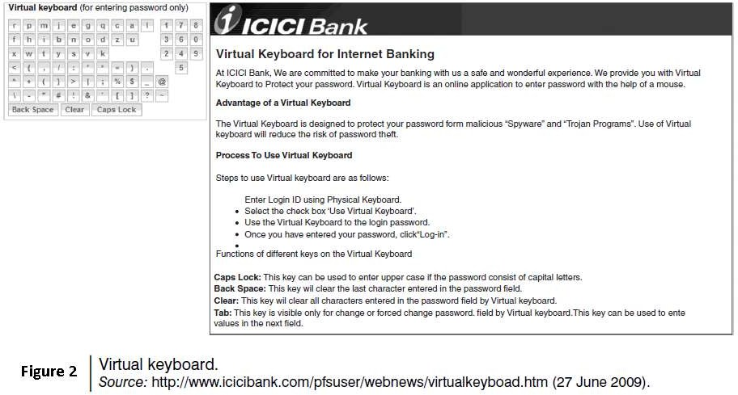

Slide 29
Cybercriminals can either install malicious programs such as keyloggers and/or Spyware or launch an attack on the target.
Here are a few tips for safety and security while using the computer in a cybercafe:
Always logout
Stay with the computer
Clear history and temporary files
Be alert
Avoid online financial transactions
Change passwords
Virtual keyboard
Security warnings

Slide 30

Beyond the Syllabus:
Awareness Theory

Slide 31
10 Common Tricks Used by Scammers:
Beware and Stay Safe:Scammers target people of all ages, but middle-aged and elderly individuals are particularly vulnerable. Be cautious and aware of these common tricks:
TRAI Phone Scam: Fraudsters claim to be from TRAI, stating your mobile
number is linked to illegal activities, and services will be suspended. -
Reality: TRAI doesn't suspend services; telecom companies do.
Parcel Stuck at Customs: Scammers claim a parcel with contraband has been
intercepted and demand payment. -
Action: Disconnect and report the number.
Digital Arrest: Fake police officers threaten digital arrest or online interrogation. -
Reality: Police don't conduct digital arrests or online interrogations.

Slide 32
Family Member Arrested: Scammers claim a relative will be arrested and demand payment.
-
Action: Verify with family members before taking action.
Get Rich Quick Trading: Social media ads promise high returns on stock investments. -
Reality: High-return schemes are likely scams.
Easy Tasks for Big Rewards: Scammers offer high sums for simple tasks, then ask for
investment. -
Reality: Easy money schemes are scams.
Credit Card Issued in Your Name: Fake executives confirm large transactions on bogus
credit cards. -
Action: Check with your bank.
Mistaken Money Transfer: Scammers claim incorrect transactions and ask for refunds.
Action: Verify transactions with your bank.
KYC Expired: Scammers ask for KYC updates via links. - Reality: Banks require in-person KYC updates.
Generous Tax Refund: Fraudsters pose as tax officials, asking for bank details.
Reality: Tax departments already have bank details and communicate directly.

Slide 33
Stay Safe:
1. Verify information before acting.
2. Don't click suspicious links.
3. Confirm transactions with banks.
4. Report suspicious calls/numbers.
5. Be cautious of high-return schemes.
6. Update KYC in-person.
7. Don't share personal/bank details.

Slide 34
Report Scams:
1: GOI Chakshu portal @ https://sancharsaathi.gov.in/sfc/
2a. National Consumer Helpline (1800-11-4000)
2b. Cyber Crime Reporting Portal (cybercrime.gov.in)
3. Local Police Station
Stay informed, stay vigilant!

Slide 35
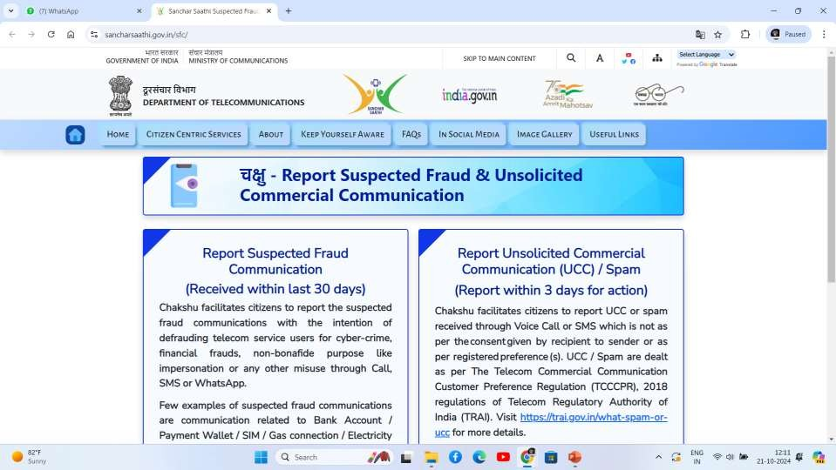

Slide 36
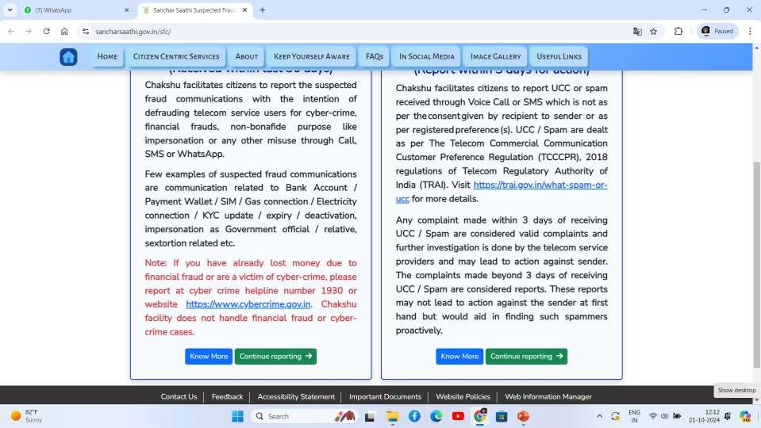

Slide 37
Financial Fraud Brochures final.pdf

Slide 38
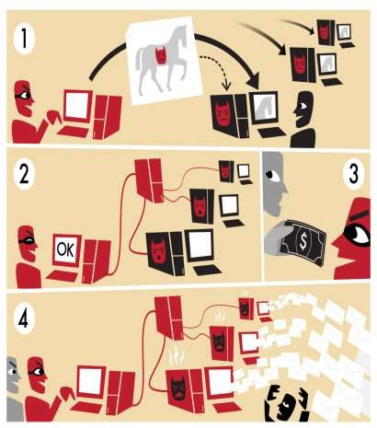
Botnet: The fuel of Cybercrime
A Botnet (also called as zombie network) is a network of computers infected with a malicious program that allows cybercriminals to control the infected machines remotely without the users’ knowledge.
Your computer system maybe a part of a Botnet
even though it appears to be operating normally.
Botnets are often used to conduct a range of
activities, from distributing Spam and viruses to
conducting denial-of-service (DoS) attacks.
Evolution of Botnets
Motivation change in computer hacking
Vandalism
Financial gains

Slide 39
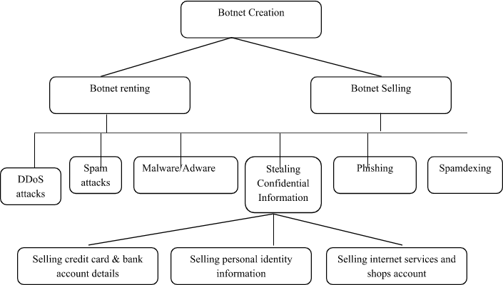
How botnets creates the business

Slide 40
One can ensure following to secure the system:
Use antivirus and anti-Spyware software and keep it up-to-date.
Set the OS to download and install security patches automatically.
Use a firewall to protect the system from hacking attacks while it is connected on the
Internet.
Disconnect from the Internet when you are away from your computer.
Downloading the freeware only from websites that are known and trustworthy
Check regularly the folders in the mail box – “sent items” or “outgoing” – for those messages you did not send.
Take an immediate action if your system is infected.

Slide 41
Attack vector
An attack vector is the path, method, or technique that a cyber attacker uses to gain unauthorized access to a computer system, network, or application in order to steal data, spread malware, or disrupt services.

Slide 42
Common Attack Vectors
Attack Vector | Description | Example
Phishing | Fake emails or messages that trick users into revealing sensitive information. | Fake bank login email
Weak Passwords | Easy-to-guess passwords allow unauthorized access. | Password: "123456"
Malware | Malicious software installed through downloads or attachments. | Opening an infected email attachment
Software Vulnerabilities | Exploiting bugs in outdated software. | Attacking an unpatched operating system
Social Engineering | Manipulating people into revealing confidential information. | Pretending to be IT support
Insider Threats | Employees intentionally or accidentally misuse access. | Employee copying confidential data
USB Devices | Infected USB drives spread malware. | Plugging in an unknown USB drive
Misconfigured Systems | Incorrect security settings expose systems. | Publicly accessible database

Slide 43
How an Attack Vector Works
The attacker identifies a weakness.
The attacker selects an attack vector.
The attacker exploits the weakness.
The attacker gains unauthorized access.
The attacker steals data, installs malware, or disrupts services.

Slide 44
Cloud Security
Cloud computing services, while offering considerable benefits and cost savings makes it easier for
cybercriminals to attack these systems.
Cloud computing is Internet (“cloud”)-based development and use of computer technology (“ computing”).
A cloud service has three distinct characteristics which differentiate it from traditional
hosting:
It is sold on demand
it is elastic in terms of usage
the service is fully managed by the provider.
Advantages of Cloud Computing
Cloud computing has following advantages:
Applications and data can be accessed from anywhere at any time.
It could bring hardware costs down.
Organizations do not have to buy a set of software or software licenses for every employee and the
organizations could pay a fee to a cloud computing company.
Organizations do not have to rent a physical space to store servers and databases. Servers and digital storage devices take up space.
Organizations would be able to save money on IT support because organizations will have to ensure
about the desktop (i.e., a client) and continuous Internet connectivity instead of servers and other hardware.

Slide 45
The cloud computing services can be either private or public.
A public cloud sells services to anyone on the Internet.
A private cloud is like a proprietary network or a data center that supplies the hosted
services to a limited number of people.
Types of Services
Services provided by cloud computing are as follows:
Infrastructure-as-a-service (IaaS)
Platform-as-a-service (PaaS)
Software-as-a-service (SaaS)

Slide 46
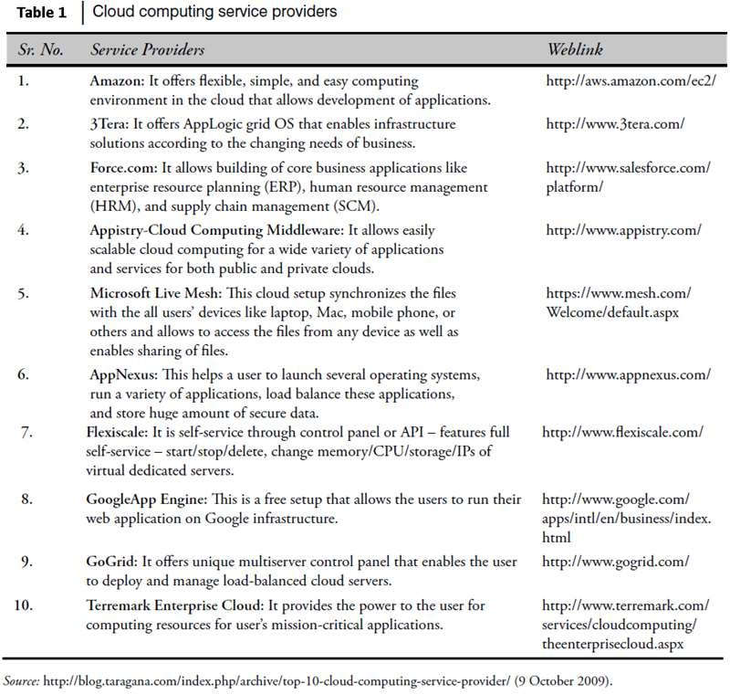

Slide 47
Cybercrime and Cloud Computing
Prime area of the risk in cloud computing is protection of user data.
Table 2 shows the major areas of concerns in cloud computing domain.

Slide 48
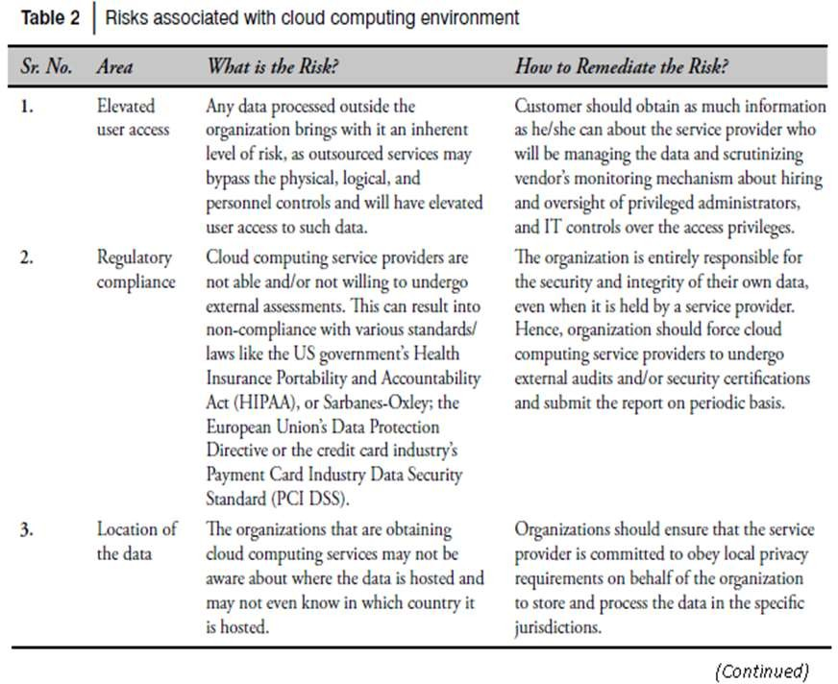

Slide 49
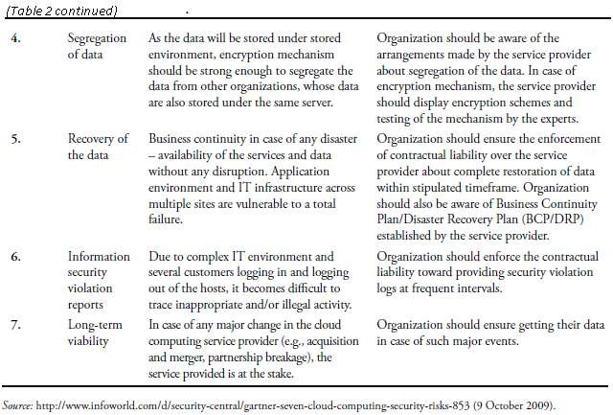

Slide 50
Course Outcomes (COs)
Upon completion of course the students will be able to
analyze cyber offences and implement effective countermeasures

